Slide 1
GOOGLE SEARCH aNALYSIS

Slide 2
cONTENTS
Abstract
Introduction
System Requirements
Architecture
Uses of data Analysis Library
Advantages
Conclusion

Slide 3
Abstract
In 2025, Google Search continues to serve as a dynamic mirror of global curiosity, concern, and behavior. This project, titled Google Search Analysis, aims to explore, interpret, and derive meaningful insights from global search trends across diverse sectors such as healthcare, technology, finance, education, environment, entertainment, and politics. By leveraging data from Google Trends and applying advanced analytical techniques—including natural language processing (NLP), sentiment analysis, and time-series forecasting—this study captures not only what people are searching for but also when, where, and why these queries emerge.
The objective is to decode evolving societal interests and digital behavior across geographies and timelines, offering valuable foresight for businesses, policymakers, researchers, and educators. Ultimately, this analysis positions search data as a strategic tool for understanding public sentiment, identifying emergent trends, and informing data-driven decisions in a digitally interconnected world.

Slide 4
introduction
The internet has revolutionized how information is accessed, and at the forefront of this transformation stands Google Search—one of the most widely used tools for discovering knowledge, solving problems, and making decisions. Every day, billions of queries are made on Google, generating a vast and rich dataset that reflects the interests, needs, and behaviors of people across the globe.
This project investigates how global search patterns in 2025 reflect human behavior across various dimensions. It utilizes Google Trends data to analyze the frequency and nature of searches spanning sectors like healthcare, finance, technology, education, the environment, and more. The aim is to uncover actionable patterns by applying data analysis, visualization, natural language processing, and machine learning models.
Through this research, we seek to answer critical questions: What topics are gaining or losing public attention? How do trends differ by region and time? What insights can be drawn about society’s evolving priorities? By addressing these questions, the project provides a data-driven lens through which global digital activity and societal evolution can be understood.

Slide 5
System requirements
Operating System:
windows 10/11
Software Requirements:
python 3.8 or Higher
Anaconda or Jupyter Notebook
Google Colab
Python Libraries:
Pandas: Install the pandas library using pip, a package manager for python.
pip install pandas

Slide 6
System requirements
Matplotlib: Install the Matplotlib library using the pip as well
pip install matplotlib
Seaborn: Install the seaborn library using pip command
pip install seaborn
Hardware Requirements:
IDE: Jupyter Notebook
Storage Space: Free storage space enough for running on machine

Slide 7
Architecture
The architecture of the Google search Analysis using Python.Matplotlib, and Pandas involves several key steps that form a cohensive workflow
The process typically data acquisition, data preprocessing, data visualization
Let’s explore the architecture in more detail:
Importing the Dataset
Data Exploration
Data Cleaning
Data Grouping
Data Visualisation

Slide 8


IMPORTING DATASET
The project with data collection, Where the Google search Analysis is sourced from reliable websites or research databases. The dataset is then loaded into the Python Environment using the Pandas library, creating structured DataFrame for efficient data handling.

Slide 9
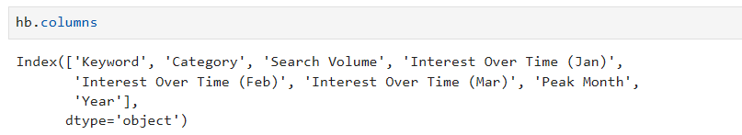

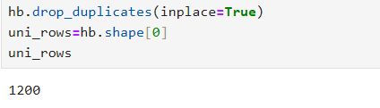
Data exploration
The data exploration phase involves examing the dataset’s basic structure using Pandas functions like head(),info(), and describe() to gain intial insights

Slide 10
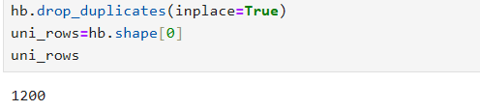
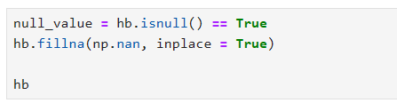
Data cleaning
The data cleaning is performed to handle missing values,duplicates,and irrelevant columns, ensuring the dataset is ready for analysis .Any inconsistencies or data quality issues are addressed during this stage.

Slide 11
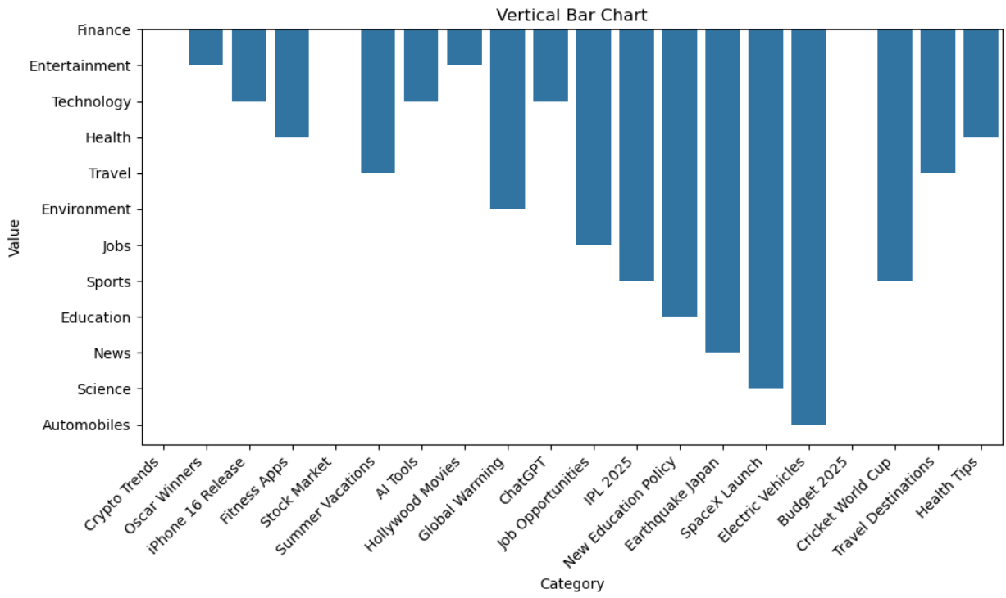
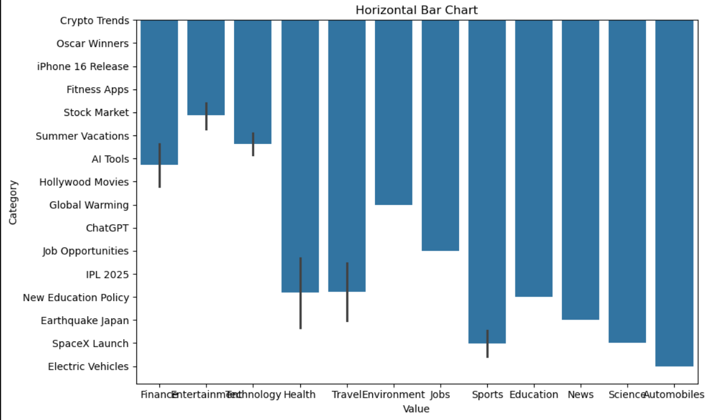
Data visualisation:
To effectively communicate the analysis results,Matplotlib and Seaborn are employed to create informative and visually appealing data visualizations.Scatter plots, bar plots, box plots, and heat maps are utilized to present the realtionships and distrubutions of the dataset attributes. These visualizations and in interpreting the analysis outcomes and uncovering hidden trend.

Slide 12
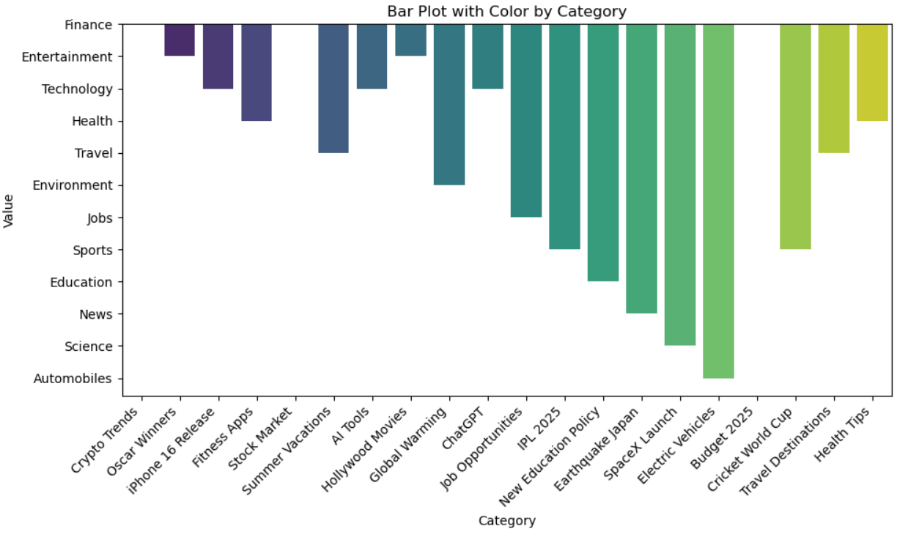
Data visualiSATION

Slide 13
USES OF DATA ANALYSIS LIBRARY
PANDAS
SEABORN :
Enchanced Data Visualization: Seaborn is bulit on top of matplotlib and offers more aesthically pleasing and informative visualizations.Its simplifies the creation of complex plots like heatmaps,pair plots and violin plots.
Categorical Data Visualization: It excels at visualizing categorical data, such as room types or customer nationalities,using bar plots or box plots ,which aids in understanding prefrences and trends
PANDAS:
Data Manipulation: It allows filtering ,Grouping, and aggregation data to drive meaningful insights.
Handling Missing Data: Pandas’ functions handle missing data points effectively, ensuring data quality and preventing biases in the analysis
Joining and Merging: pandas is used to combine datasets when additional information,such as category.
MATPLOTLIB:
Data Visualization: Matplotlib allows the creation of various visualizations like line plots, bar charts, and scatter charts, revenue fluctuations, and customer distribution.
Time series Analysis: With Matplotlib time series plots can illustrate booking patterns over specific time intervals, highlighting seasonal varations and trends.

Slide 14
advantages
Versatility and Flexibility: Python, as a programming language, is highly versatile and flexible, allowing easy intergration with various data sources and formats.This enables hoteliers to analyze data from different booking platfroms and internal databases seamlessly.
Rich Data Analysis Libraries: Pandas, Matplotlib, and seaborn provide a comprehensive suite of data manipulation,visualization, and statistical functions.Their extensive capabilities empower analysis to perform complex data analysis and generate informative visualizations with relative ease.
Data Visualization: Matplotlib and seaborn excel at creating visually appealing and informative plots,charts,and graphs .These visualizations enhance the presentation of complex data, making it easier for stakeholders to understand trends,patterns,and correlations.
Data-Driven Decision Making: By analyzing patterns,customer prefrences , and revenue trends, hotel management can make data-driven decisions to optimize pricing ,marketing strategies, and operational efficiency. This leads to betters resource allocations and improved Data.

Slide 15
conclusion
The Google Search Analysis project offers a powerful glimpse into how search behavior mirrors the evolving interests, concerns, and priorities of society in 2025. By leveraging data from Google Trends and applying advanced analytical techniques, we successfully decoded patterns across multiple sectors and geographic regions.
Our analysis demonstrated how digital search data can be transformed into actionable insights, helping businesses, researchers, and policymakers make informed decisions. The use of Python libraries like Pandas, Matplotlib, and Seaborn enabled us to process and visualize large datasets efficiently and meaningfully.
This project not only highlights the value of search data in understanding public sentiment but also reinforces the importance of data-driven approaches in tracking global trends. Going forward, such analyses can play a critical role in forecasting behavior, identifying emerging topics, and guiding strategic planning in a rapidly evolving digital world.

Slide 16
Team members
Indrani Labala [22P31A42A4]
Jakkula Abhilash Kumar[22P31A4437]
Rongala Meghana[22P31A42B4]
Kone Veera Sravani[22P31A4299]
Polisetti Ambica Prasanna[22P31A42B0]

Slide 17
Thank you

